Slide 1
Pre & Post 5G Launch (AtliQo)- KPI Comparison Report
Insights & Recommendations for Business Recovery

Slide 2
Overview
5G launched in May 2022.
Notable decline in active users and revenue growth post-launch.
Objective: Compare Pre-5G (Jan–Apr) vs Post-5G (Jun–Sep) KPIs to uncover root causes and actionable insights.

Slide 3
Dataset Overview
We have provided 6 CSV files:
1. dim_cities
2. dim_date
3. dim_plan
4. fact_atliqo_metrics
5. fact_market_share
6. fact_plan_revenue

Slide 4
KPI’S
Total Revenue
Avg Revenue
Average Revenue Per User
Total Active Users
Total Unsubscribed Users
Monthly active users
Market Share %
Revenue Before 5G
Revenue After 5G
ARPU Before 5G
ARPU After 5G
Active Users Before 5G
Active Users After 5G
Unsubscribed users Before 5G
Unsubscribed users After 5G

Slide 5
Creating Database

Slide 6
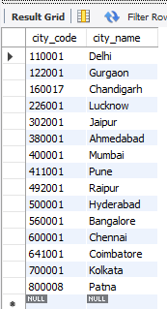
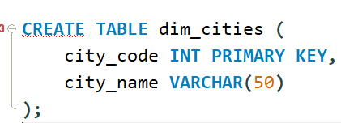
Creating dim_cities Table

Slide 7
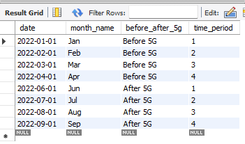
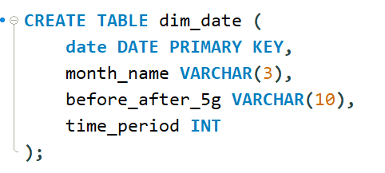
Creating dim_date Table

Slide 8
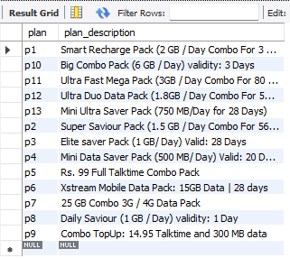
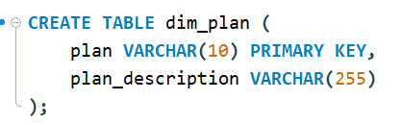
Creating dim_plan Table

Slide 9
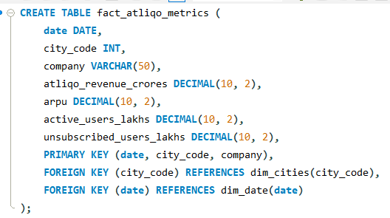
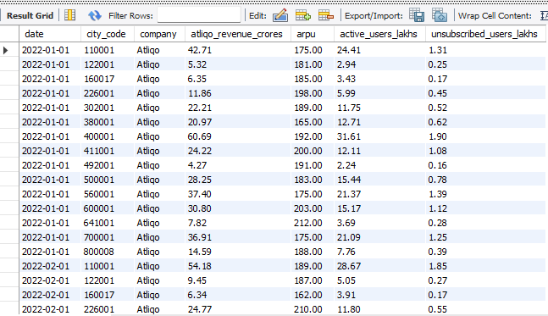
Creating fact_atliqo_metrics Table

Slide 10
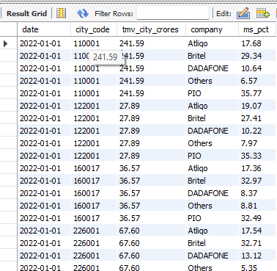
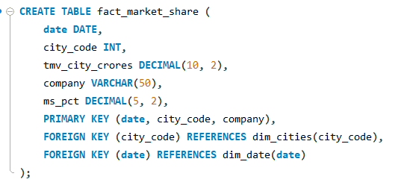
Creating fact_market_share Table

Slide 11
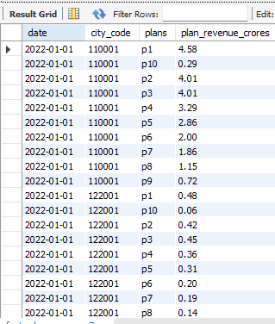
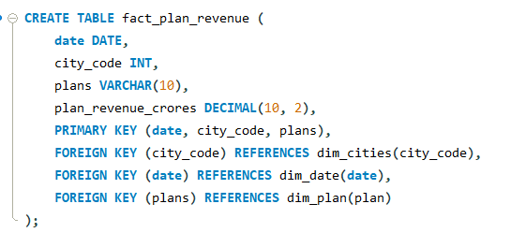
Creating fact_market_share Table

Slide 12

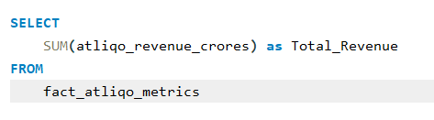
1. Total Revenue

Slide 13
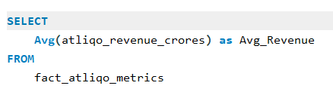

2. Avg Revenue

Slide 14
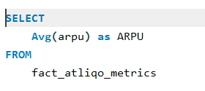

3. Average Revenue Per User

Slide 15

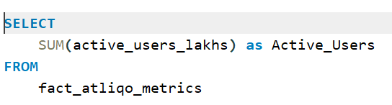
4. Total Active Users

Slide 16
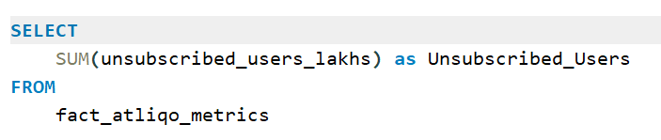

5. Total Unsubscribed Users

Slide 17
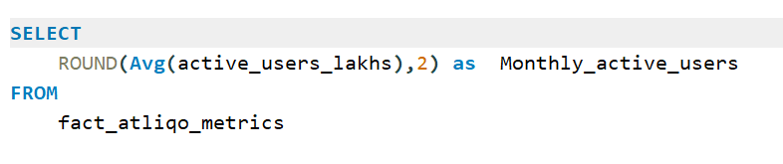

6. Monthly active users

Slide 18
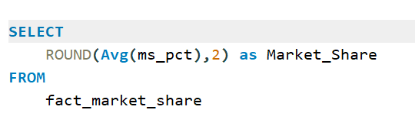

7. Market Share %

Slide 19
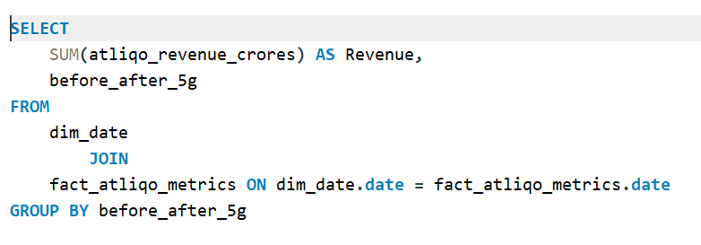

8. Revenue Before 5G and After 5G

Slide 20
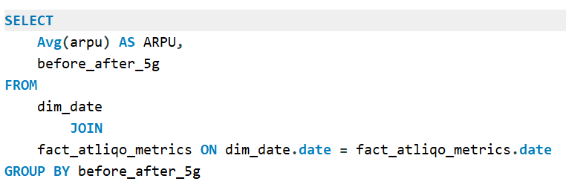

9. ARPU Before 5G and After 5G

Slide 21
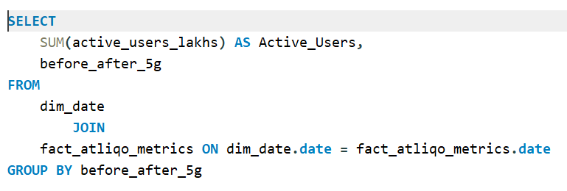

10. Active Users Before 5G and After 5G

Slide 22
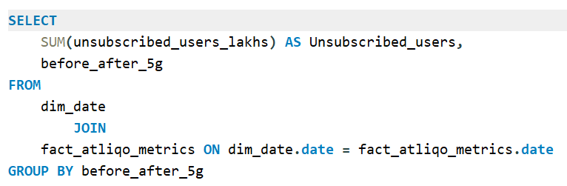

11. Unsubscribed users Before 5G and After 5G

Slide 23
Key Insights:
Decline in Total Revenue and Active Users post-5G launch.
ARPU (Average Revenue Per User) dropped significantly, indicating reduced customer spending or plan downgrade.
Unsubscribed users increased, reflecting dissatisfaction or poor customer retention.
Market Share declined, suggesting competitors capitalized on AtliQo's transition phase.

Slide 24
Recommendations
Re-evaluate 5G Pricing Strategy – Align plan pricing with customer expectations and competitor offerings.
Customer Retention Initiatives – Launch loyalty programs or exclusive offers for long-term users.
Service Quality Feedback Loop – Use NPS and churn data to identify 5G service pain points.
Aggressive Marketing Campaigns – Focus on cities and demographics with largest churn rates.
Segmented Plans – Offer customizable plans based on usage patterns post-5G.
Improve Onboarding Experience – Ensure smooth migration to 5G with better support and incentives.

